Slide 1

THE DIFFERENT BETWEEN VIETNAM AND FRANCE
STUDENT：NGO NGOC LAM (TIAN)

Slide 2
1. GEOGRAPHY
2.ECONOMY
The differents
3. LANGUAGE
4.CULTURE

Slide 3
1
GEOGRAPHY

Slide 4
GEOGRAPHY
01
02
03
CONTINENT
France is in Europe
VietNam is in Asian
AREA
Area of VietNam is over half of France
CLIMATE
France has ocean climate
And VietNam is about tropical monsoon

Slide 5
2
ECONOMY

Slide 6


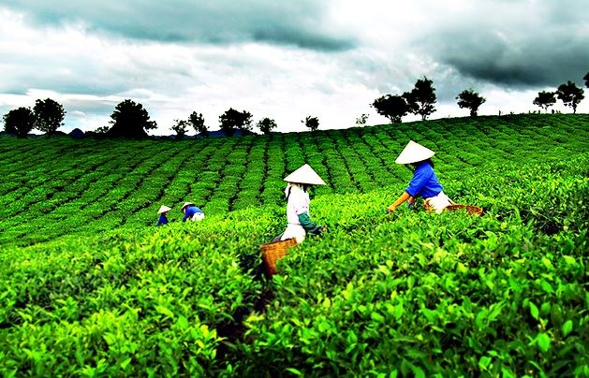

ECONOMY
VIET NAM
FRANCE
VIET NAM
FRANCE

Slide 7
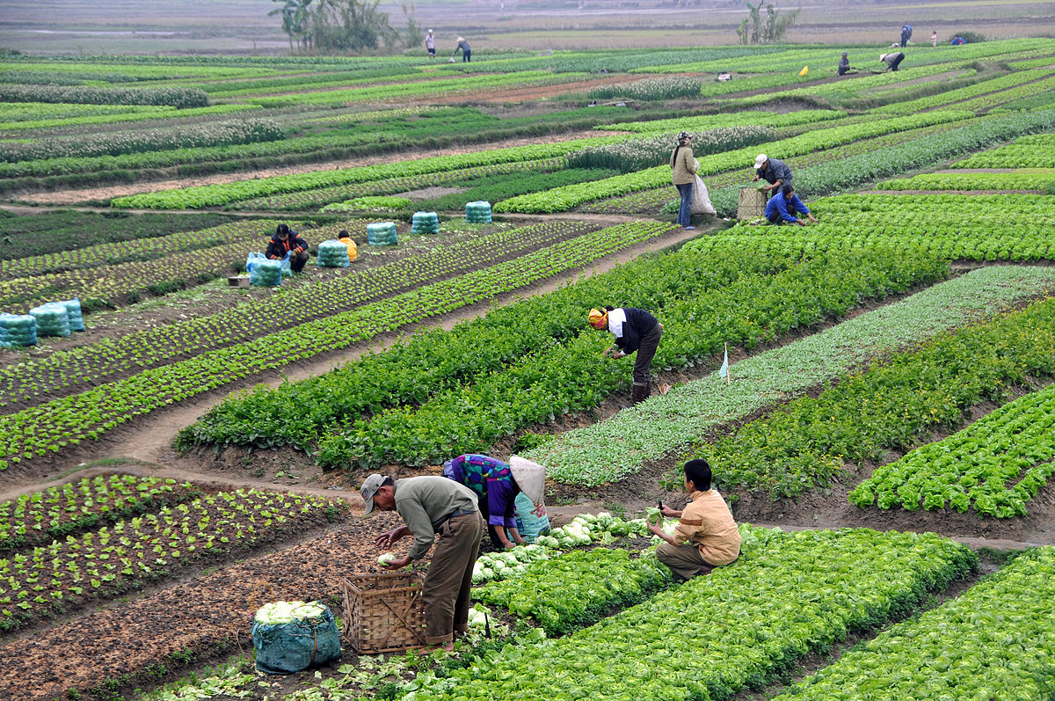
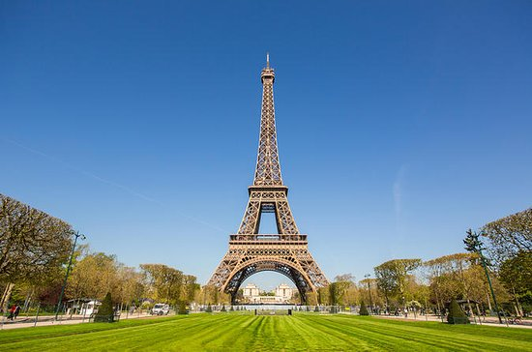
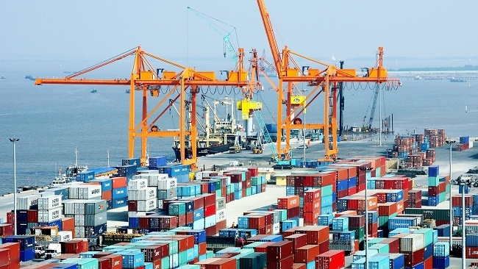
ECONOMY
INDUSTRY
France is very developed
VietNam is developing
AGRICULTURE
TOURISM
3.8% of French workers work in agriculture and of Viet Nam is about 30%
France attract by the Eiffel Tower Vietnam attract by the natural landscape

Slide 8
3
LANGUAGE

Slide 9
LANGUAGE
French appeared in the 9th century.
Modern Vietnamese appeared in 1865.
Vietnamese and French are the same in vocal

Slide 10
4
CULTURE

Slide 11

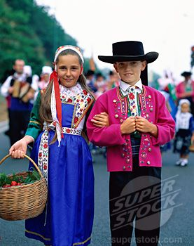

CULTURE
RACE
French is Europeoid.
Vietnamese is Mongoloid
French uses knife and fork, he usually eats food from wheat and beef.
Vietnamese likes using chopsticks and eats rice with pork
EATING CULTURE
FRANCE
VIETNAM
TRADITIONAL CUSTUME

Slide 12

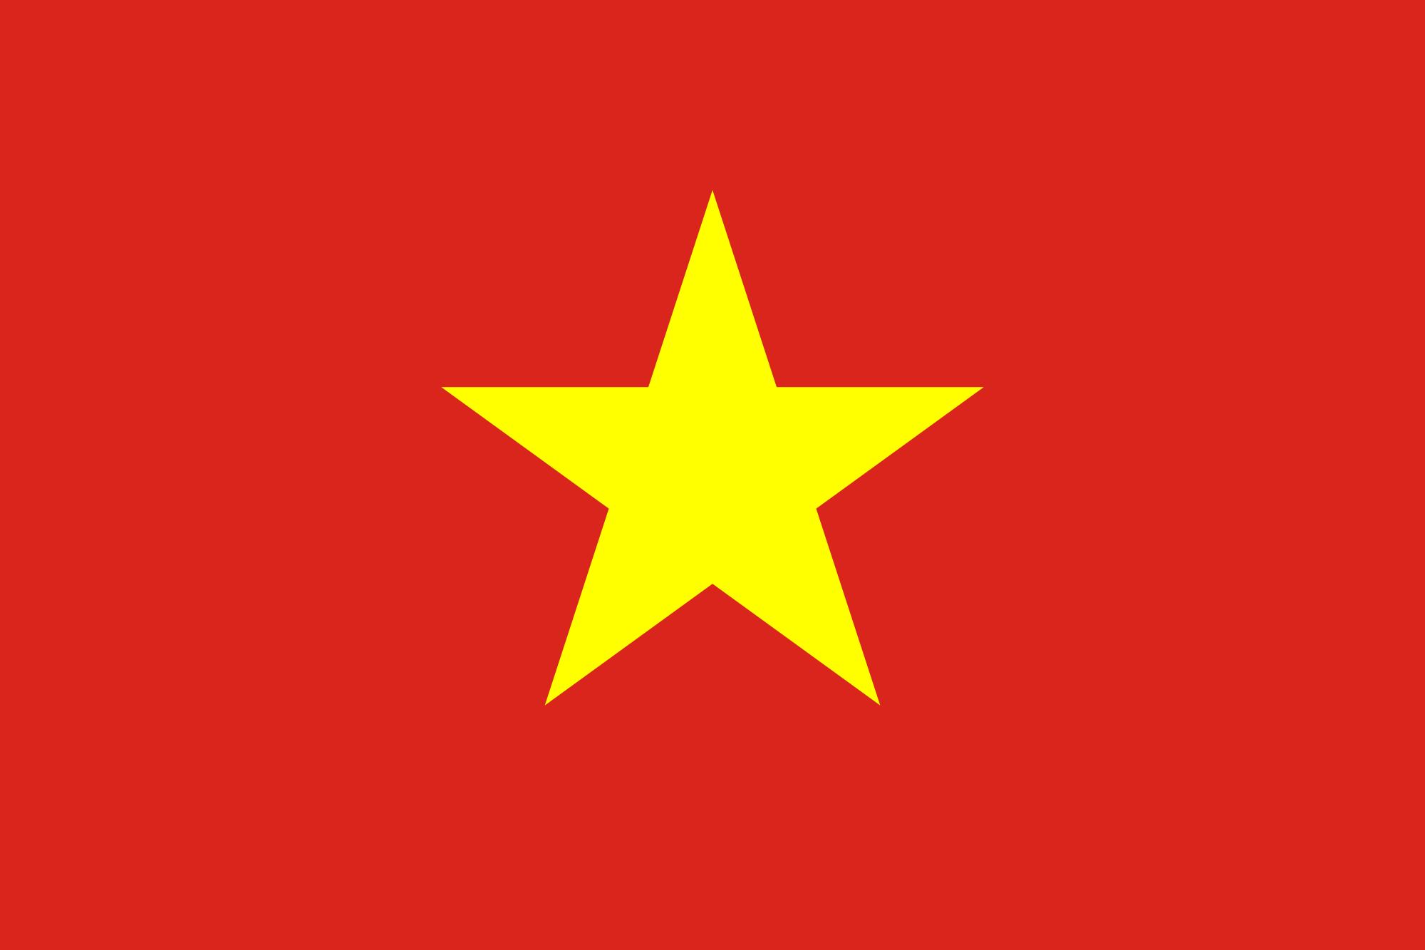
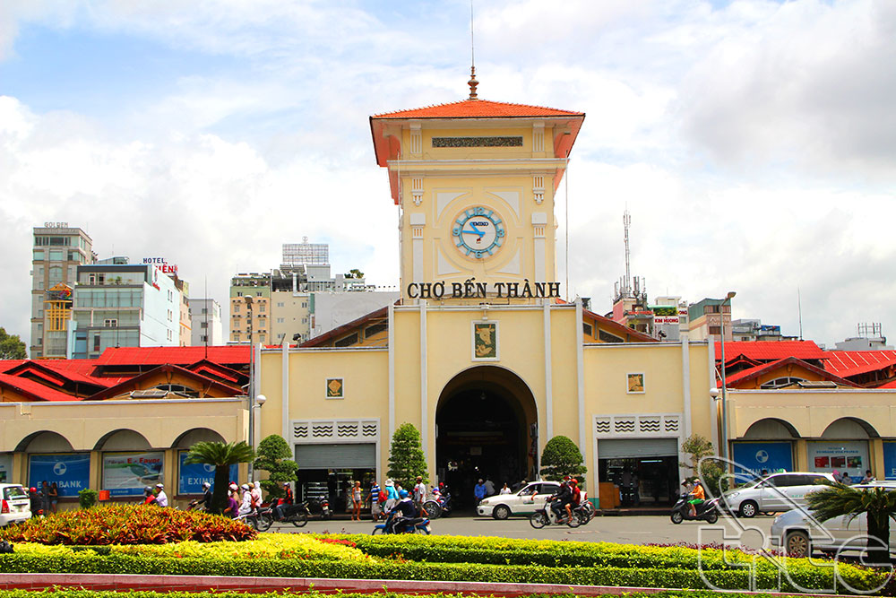
CONCLUTION
WE ARE ONE
France, Vietnam or 191
Countries other are brothers in one home – The Earth.
THE PEACE
We should keep the peace for a wonderful world today and in the future.
TO PROTECT OUR ENVIRONMENT
We have to protect our Earth, our environment as well as our health.
COOPERATION
Cooperation for development, anti-war and improve our life quality.

Slide 13
THANKS FOR WATCHING
STUDENT: NGÔ NGỌC LAM (TIAN)

